Slide 1




Account Management System
A project by:
Muhammad Waseem – FA24-BAI-020
Umar Saadat – FA24-BAI-026
Muhammad Awais – FA24-BAI-019
Database & Programming
Umar Saadat & Muhammad Waseem
UI/UX Design
Muhammad Awais

Slide 2
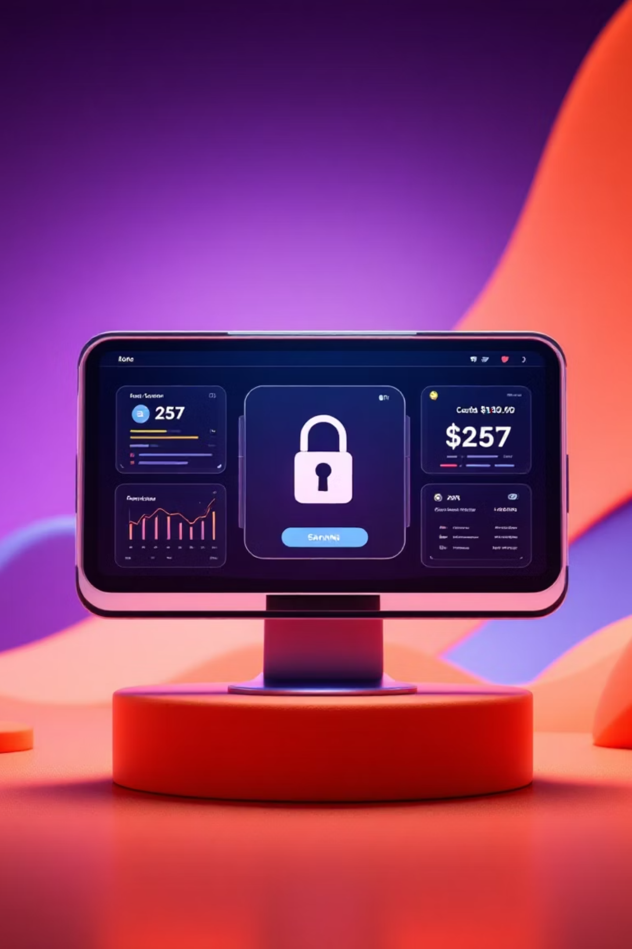
Introduction: Project Objectives & Scope
Objective
Develop an efficient system for user account management, including creation, login, money transfers, bill payments, and transaction tracking. Focus on user-friendliness and secure data.
Scope
Account registration & authentication
Balance management
Transaction history & PDF reports
Bill payment integration

Slide 3




Problem Statement: The Need for Automation
Manual Management
Error-prone and inefficient account handling.
Lack of Automation
Users need an automated, secure, and accessible system.
Tracking Challenges
Difficulty tracking financial transactions and history without a centralized system.

Slide 4
Key System Features
User Registration & Login
Dashboard
Send Money
Current balance and quick actions.
Online transfers between accounts.
Unique account number, CNIC, email, password.
Bill Payment
Transaction History
Integrated with electricity, gas, and PTCL bills.
View past transactions and generate PDF reports.

Slide 5

Tools & Technologies Utilized
Programming Language: Python
GUI Library: CustomTkinter,Tkinter (modern look & feel)
Database: MySQL (via MySql.Connector)
PDF Generation: FPDF
IDE: VS Code
UI/UX design was handled by Muhammad Awais, ensuring a polished user experience.

Slide 6




System Architecture & Design
Frontend
Backend
Csutom Tkinter with modern UI.
MySql.Connector connects
Python Program to Sql Workbench
Database Design
PDF Reports
Tables for Registration, Login, Balance, Transaction_History, Account_Details.
FPDF for generating account and transaction statements.

Slide 7
Database Design: Structure & Integrity
Our database is structured with five key tables to ensure robust data management:
Registration
User personal details & account number
Login
Authentication credentials
Balance
Account balances
Account_Details
Account info for display & PDF reports
Transaction_History
Records of all transactions
Keys & Constraints: Primary key: Account_Number. Foreign keys link tables. Validation for email, CNIC, and DOB ensures data integrity.

Slide 8
User Interface (UI/UX) Design
Clean, Modern Interface
Intuitive Forms
Interactive History
Utilizes FlatLaf for a sleek and intuitive design.
Easy-to-use forms for registration, money transfers, and bill payments.
Transaction history displayed in a table with PDF export functionality.

Slide 9
System Workflow: Step-by-Step Process
01
02
03
Registration
Login
Send Money
User enters details, which are validated and stored in the database.
Email & password verified, leading to the dashboard display.
Balance validated, sender & receiver accounts updated, transaction logged.
04
05
Check Bill Payment
Transaction History & PDF
Select biller, input reference, and proceed to
Check payment page.
Records fetched and PDF reports generated.

Slide 10

Conclusion: A Secure & Efficient Solution
Fully Functional
Developed a complete account management system.
Integrated Design
Seamless frontend, backend, and database integration.
User-Centric
Provides secure, efficient, and user-friendly account management.
Future Ready
Designed for future extensions with additional financial features.

